Slide 1
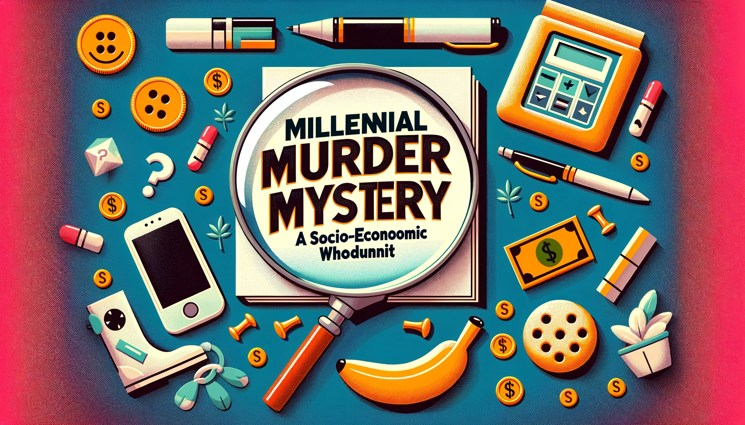
Detectives: Alison Love, George Liberatos, Luke Brocker

Slide 2
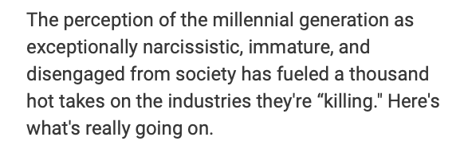
The Crime

Slide 3

The Victims
Home
Ownership
Alcohol
Cereal
Luxury
Products
Murdered!
Murdered!
Murdered!
Murdered!
“Rent Forever: The Share of Millennials Who Say They'll Never Own a Home Is Surging.”
“The breakfast food that’s too ‘inconvenient’ for millennials may actually just be too sugary.”
“When millennials do drink beer, they’re more likely to choose craft beers.”
“Millennials care about experiences instead of things, so they’re not buying sports cars and luxury watches.”

Slide 4
The Allegations

Slide 5
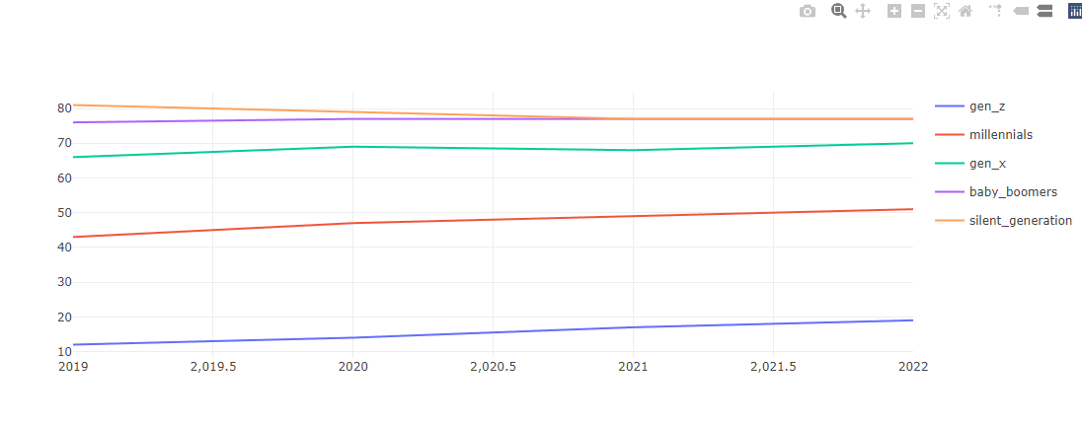
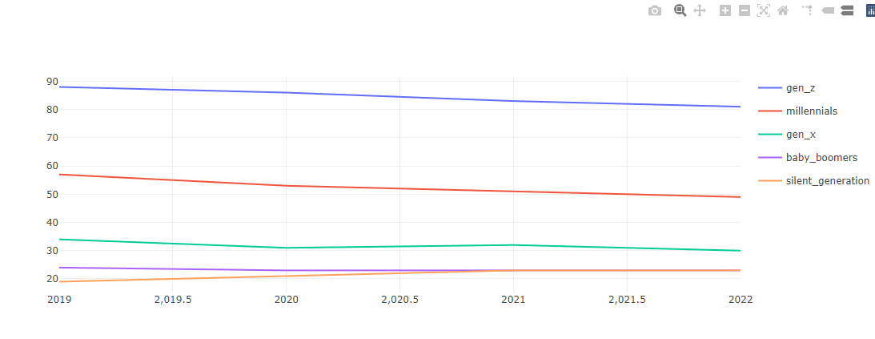
The Death of
Home Ownership
Home Ownership: Renting vs. Buying
Are Millennials: Guilty or not Guilty?
Owners
Renters
NOT GUILTY

Slide 6
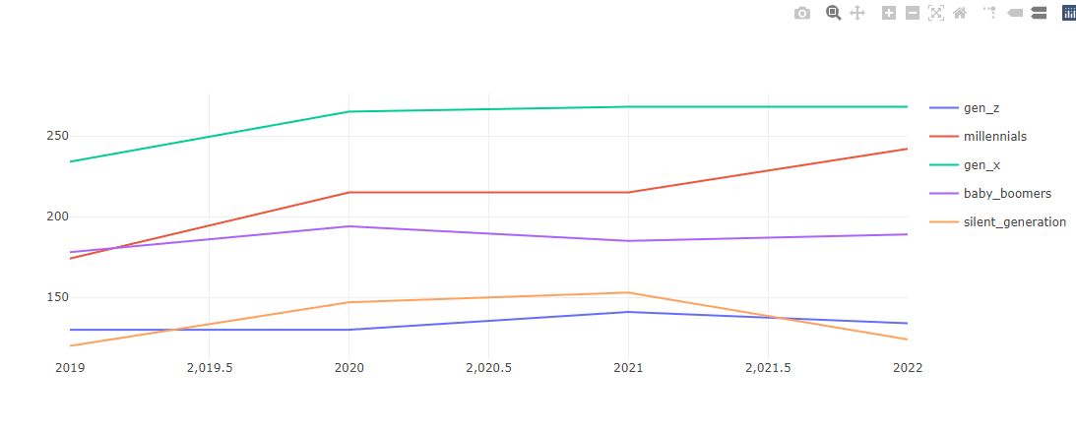
The Neglect of
Cereal Products
The consumption of cereal products.
Are Millennials: Guilty or not Guilty?
NOT GUILTY

Slide 7
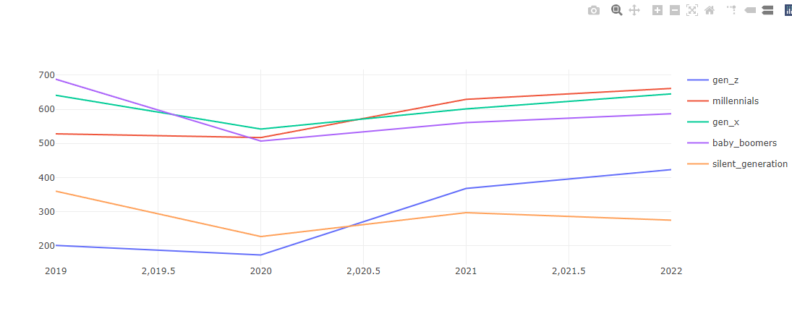
The Murder of
Alcohol
Alcohol Consumption: Craft Beer killing the alcohol industry?
Are Millennials: Guilty or Not Guilty?
NOT GUILTY

Slide 8
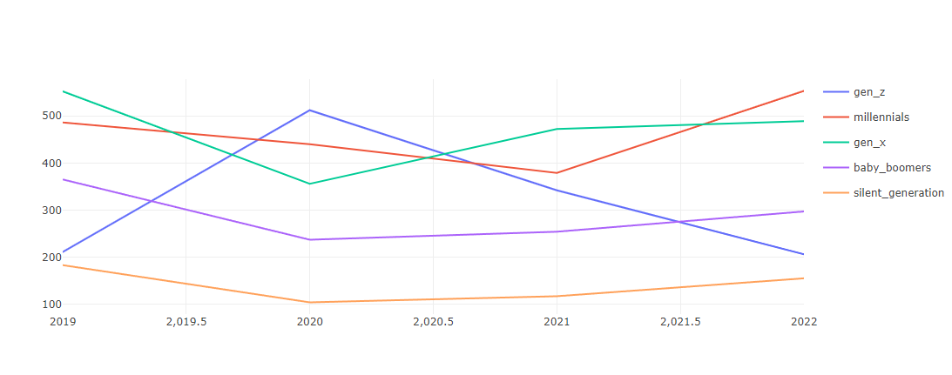
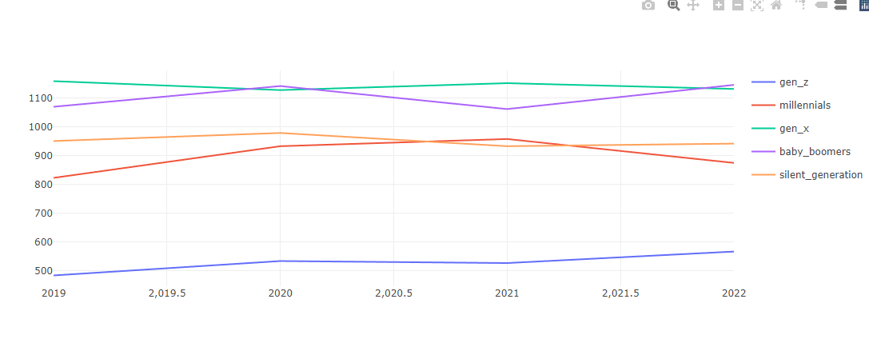
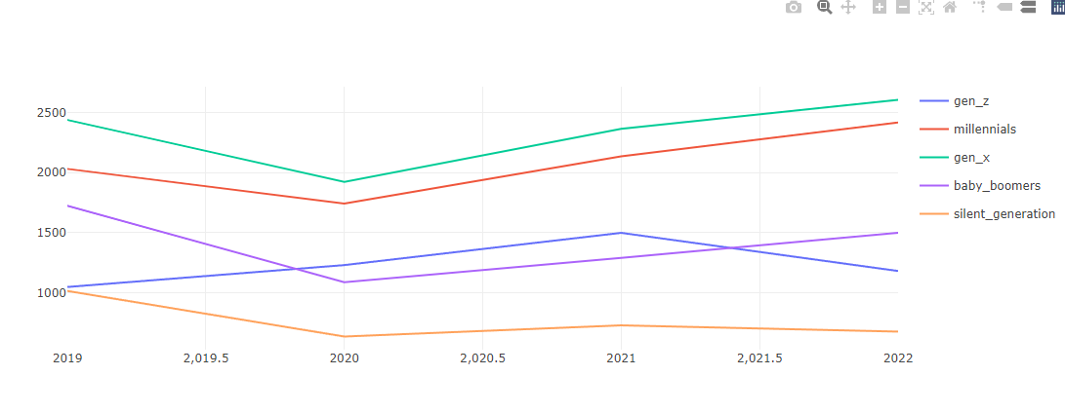
The Destruction of
Luxury Products
Luxury Products: Is there less of a need for them?
Are Millennials: Guilty or Not Guilty?
Footwear
Audio and Visual Equipment
Luxury Apparel
NOT GUILTY

Slide 9
Who is the Real Culprit?
What do you think?
Discover for Yourself!
Sources: https://www.cbinsights.com/research/millennials-killing-industries/

